Slide 1

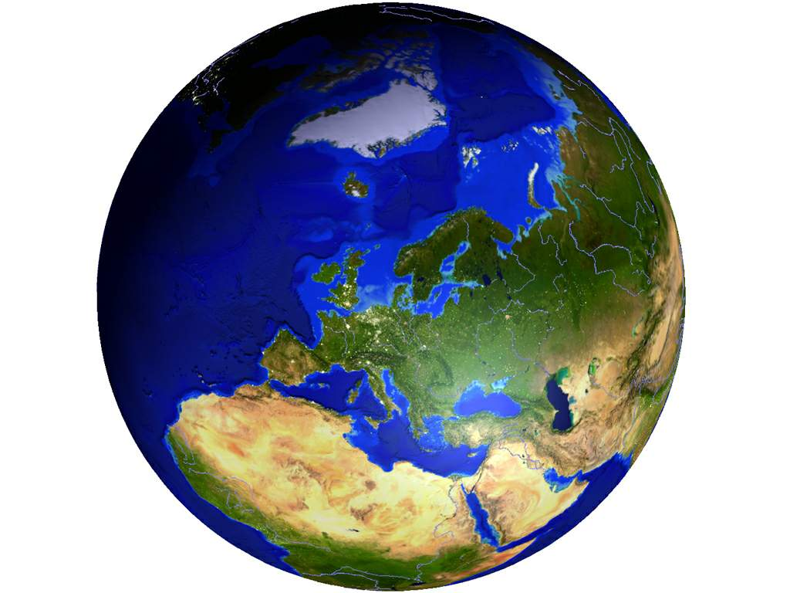
Jesse’s Perfect (not) Population PowerPoint

Slide 2


Key
10 Most Populated Countries | 10 Most Densly Populated Countries
China | Monaco
India | Singapore
United States | Vatican City
Indonesia | Maldives
Brazil | Malta
Pakistan | Bangladesh
Bangladesh | Bahrain
Nigeria | Taiwan
Russia | Barbados
Japan | Mauritius

Slide 3
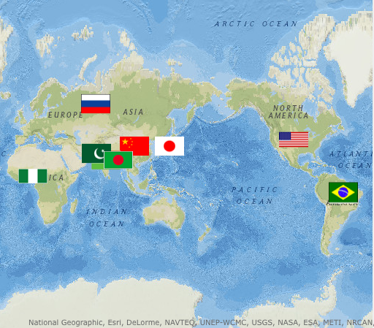
Population

Slide 4
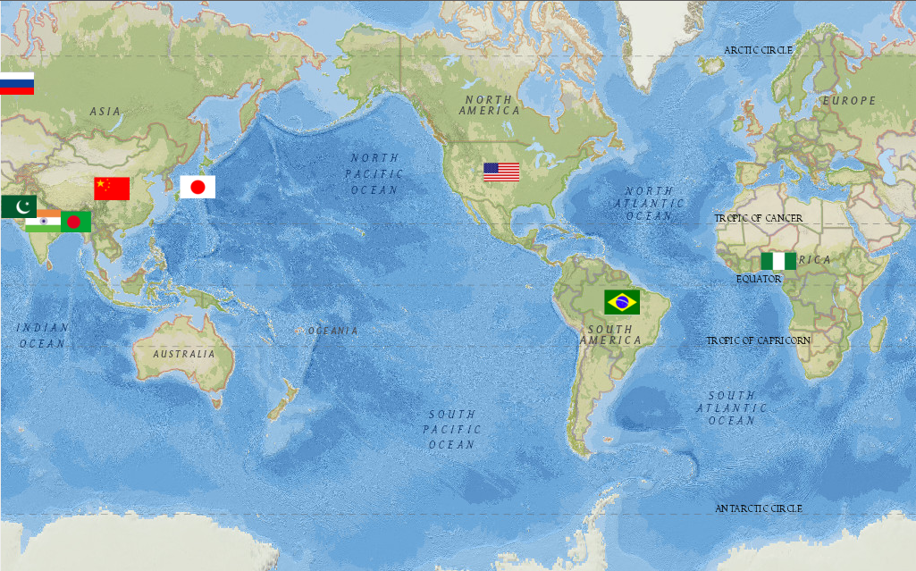
Population

Slide 5
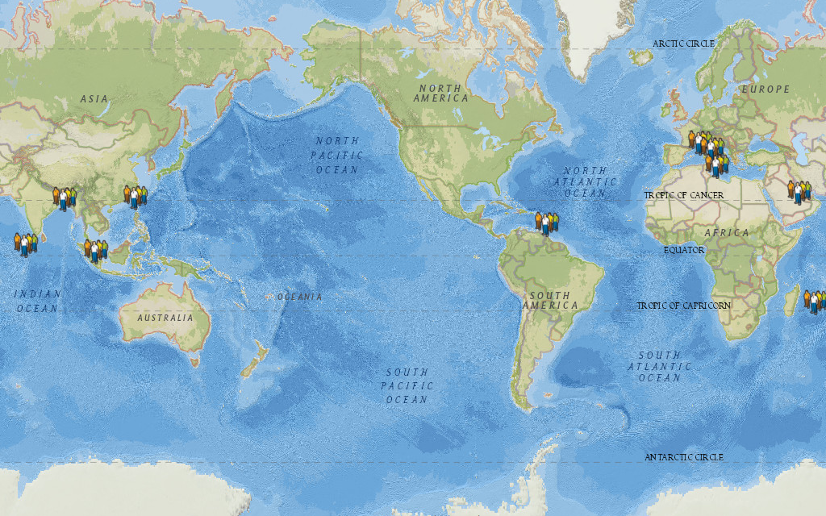
Population Density

Slide 6
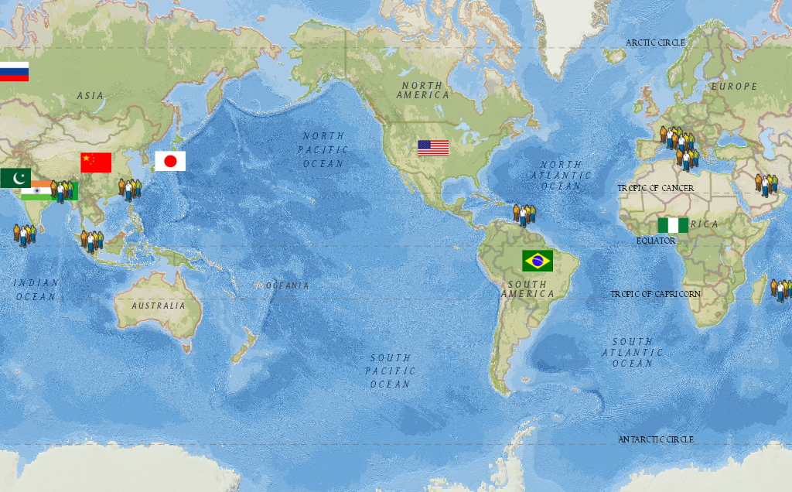
Population and Population Density

Slide 7
Made by Jesse Evers
Data From My Geography Textbook
This Map was Created as a School Project
Date Made: 1/9/12

